Slide 1
Indian Debt Market

Slide 2
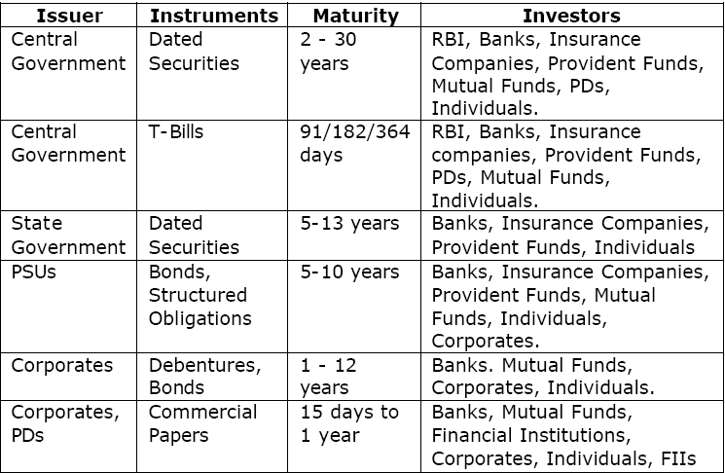
INSTRUMENTS

Slide 3
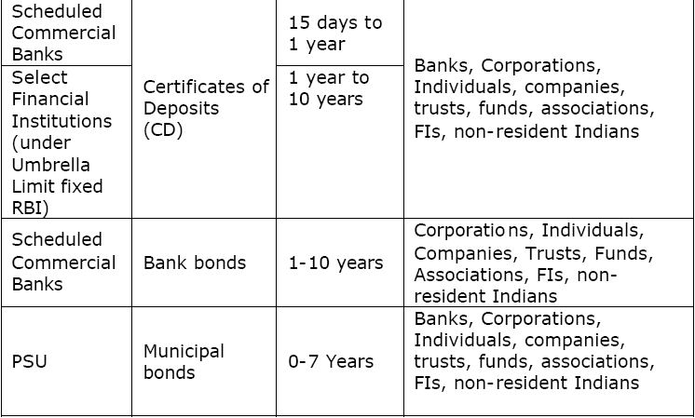
INSTRUMENTS

Slide 4
Constituent SGL A/C
SGL-Subsidiary General Ledger Account is the demat facility for government securities offered by the Reserve Bank of India. RBI offers SGL facility only to banks, primary dealers and satellite dealers.
SGL account holders can have two SGL accounts with RBI-SGL account no.1 and SGL account no.2
SGL account no.1 is the account for the own holdings of the bank or the PD or SD who has the direct account.
SGL account no.2 is for their constituents. Those who are not eligible for direct SGL account with RBI can hold securities in demat form by opening a constituent SGL account.

Slide 5
Indian Debt Market
The debt market in India comprises of two main segments, viz, the government securities market and the corporate securities market.
The main instruments in the government securities market are fixed rate bond, floating rate bonds, zero coupon bonds and inflation index bonds, partly paid securities, securities with embedded derivatives, treasury bills and the state government bonds.
The corporate debt segments includes private corporate debt, bonds issued by public sector units (PSUs) and bonds issued by development financial institutions (DFIs).

Slide 6
Debt Instruments
Debt Instruments represent contracts whereby one party lends money to another on pre-determined terms with regard to rate of interest to be paid by the borrower to the lender, the periodicity of such interest payment, and the repayment of the principal amount borrowed.
The debt instruments include all the securities issued by governments and public or private corporates.
Different debt securities can be grouped as under
a) Public Debt Instruments b) Private Debt Instruments c) Special Debt Instruments
Public Debt Instruments
These are the securities issued by Governments with maturity of long-term and short-term periods and commonly called as “Gilt-edged securities” because, the payment of interest and the repayment of principal are secured in these securities.

Slide 7
Debt Instruments
Private Debt Instruments
The debt instruments are issued by business firms which are incorporated as companies under the Companies Act, 1956. These instruments are usually secured by a mortgage on the company’s Fixed or Immovable Assets. These are marketable legal contracts whereby the company promises to pay its owner a specified rate of interest for a definite period of time and to repay the principal at maturity.
Special Debt Instruments
The Public Sector Undertakings (PSUs) issue the PSU Bonds, a special debt instrument in character, with tax incentives to the public and Financial Institutions. A large portion of these issues are privately placed either with banks or other Financials Institutions.

Slide 8
Fundamental Features
In the Indian securities market, we use the term ’bond’ for debt instruments by the Central and State governments and public sector organisations, and the term ’debentures’ for instruments issued by private corporate sector.
The principal features of a bond are a) maturity
b) Coupon c) Principal
Maturity of a bond refers to the date on which the bond matures, or the date on which the borrower has agreed to repay (redeem) the principal amount to the lender. The term to maturity refers to the number of years remaining for the bond to mature.
Term to maturity of a bond changes everyday, from the date of issue of the bond until its maturity.

Slide 9
Fundamental Features
Coupon refers to the periodic interest payments that are made by the borrower (who is also the issuer of the bond) to the lender (the subscriber of the bond). Coupon rate is the rate at which interest is paid, and is usually represented as a percentage of the par value of a bond.
Principal is the amount that has been borrowed, and is also called the par value or face value of the bond.
The coupon is the product of the principal and the coupon rate. Typical face values in the bond market are Rs.100 and Rs.1000.

Slide 10
Government Securities
The Central Government Securities (G-Secs) are the one of the best investment options for an individual investor today in the financial markets due to the following factors:
Zero default risk - due to their sovereign guarantee, ensures the total safety of all investments in G-Secs.
Lower average volatility in bond prices.
Greater returns as compared to the conventional safe investment avenues like Bank Deposits and Fixed Deposits, which also contain credit risk.
Higher leverage -Greater borrowing capacity against G-Secs due to their zero risk status
Growing liquidity and the increased turnover in recent times in the Indian Debt Markets

Slide 11
Gsecs-primary market
Government issues securities through the following modes:
a)Issue of securities through auction
The securities are issued through auction either on price basis or on yield basis. Where the issue is on price basis, the coupon is predetermined and the bidders quote price per Rs.100 face value of the security, at which they desire to purchase the security. Where the issue is on yield basis, the coupon of the security is decided in an auction and the security carries the same coupon till maturity. On the basis of the bids received, RBI determines the maximum rate of yield or the minimum offer price as the case may be at which offers for purchase of securities would be accepted at the auction

Slide 12
Primary market
b) Issue of securities with pre-announced coupon rates:
The coupon on such securities is announced before the date of floatation and the securities are issued at par.In case the total subscription exceeds the aggregate amount offered for sale, RBI may make partial allotment to all the applicants.
c) Issue of securities through tap sale:
No aggregate amount is indicated in the notification in respect of the securities sold on tap. Sale of such securities may be extended to more than one day and the sale may be closed at any time on any day.

Slide 13
d)Issue of securities in conversion of maturing treasury bills/dated securities:
The holders of treasury bills of certain specified maturities and holders of specified dated securities are provided an option to convert their holding at specified prices into new securities offered for sale.
The new securities could be issued on an auction/pre announced coupon basis

Slide 14
Types of G-Secs
Securities with fixed coupon rates: These securities carry a specific coupon rate remaining fixed during the term of the security and payable periodically. These may be issued at a discount, at par or at a premium to the face value and are redeemed at par.
Floating Rate Bonds: These securities carry a coupon rate which varies according to the change in the base rate to which it is related. The description of the base rate and the manner in which the coupon rate is linked to it is announced in the specific notification.
Zero Coupon Bonds : These are issued at a discount and redeemed at par. No interest payment is made on such bonds before maturity. On the basis of the bids received through tenders, RBI determines the cut-off price at which tenders for purchase such bonds would be accepted at the auction.

Slide 15
Types of G-Secs
Securities with Embedded Derivatives: These securities are repaid at the option of government/
holder of the security, before the specified redemption date, where a ‘call option’/’put option’ is specified in the specific notification and repaid on the date of redemption specified in the specific notification, where neither a ‘call option’ nor a ‘put option’ is specified/exercised.
Indexed Bond: Interest payments of these bonds are based on Wholesale Price Index/Consumer Price Index.

Slide 16
Treasury Bills
T-bills are short-term debt instruments issued by the central government.
The 4 types of T-bills were issued:
14-day,91-day,182-day and 364-day, representing the 4 types of tenors for which these instruments are issued.

Slide 17
Repo and Reverse Repo
Repo or Repurchase Agreements are short-term money market instruments.
Repo is nothing but collateralized borrowing and lending through sale/purchase operations in debt instruments.
Under a repo transaction, a holder of securities sell them to an investor with an agreement to repurchase at a predetermined date and rate.
In a typical repo transaction, the counter-parties agree to exchange securities and cash, with a simultaneous agreement to reverse the transactions after a given
period.
To the lender of cash, the securities lent by the borrower serves as the collateral; to the lender of securities, the cash borrowed by the lender serves as the collateral.
Repo thus represents a collateralized short term lending.

Slide 18
Repo and Reverse Repo
In a repo transaction, the securities should be sold in the first leg at market related prices and repurchased in second leg at derived price.
The sale and repurchase should be accounted for in the repo account.
On the other hand, in a reverse repo transaction, the securities should be purchased in the first leg at market related prices and sold in second leg at derived price.
The purchase and sale should be accounted for in the reverse repo account.

Slide 19
Corporate Bonds
Corporate bonds are debt securities issued by private and public corporations.
Companies issue corporate bonds to raise money for a variety of purposes, such as building a new plant, purchasing equipment, or growing the business.
When one buys a corporate bond, one lends money to the "issuer," the company that issued the bond.
In exchange, the company promises to return the money, also known as "principal," on a specified maturity date.
Until that date, the company usually pays you a stated rate of interest, generally semiannually.
While a corporate bond gives an IOU from the company, it does not have an ownership interest in the issuing company, unlike when one purchases the company's equity stock.

Slide 20
Corporate Bonds
Corporate bonds tend to rise in value when interest rates fall, and they fall in value when interest rates rise.
Usually, the longer the maturity, the greater is the degree of price volatility.
By holding a bond until maturity, one may be less concerned about these price fluctuations (which are known as interest-rate risk, or market risk), because one will receive the par, or face, value of the bond at maturity.
The inverse relationship between bonds and interest rates—that is, the fact that bonds are worth less when interest rates rise and vice versa can be explained as follows :-

Slide 21
Valuation of Corporate Bonds
When interest rates rise, new issues come to market with higher yields than older securities, making those older ones worth less. Hence, their prices go down.
When interest rates decline, new bond issues come to market with lower yields than older securities, making those older, higher-yielding ones worth more. Hence, their prices go up.
As a result, if one sells a bond before maturity, it may be worth more or less than it was paid for.

Slide 22
Yield
Yield is a critical concept in bond investing, because it is the tool used to measure the return of one bond against another.
It enables one to make informed decisions about which bond to buy.
In essence, yield is the rate of return on bond investment.
However, it is not fixed, like a bond’s stated interest rate.
It changes to reflect the price movements in a bond caused by fluctuating interest rates.

Slide 23
Current Yield
The current yield is the annual return on the amount paid for a bond, regardless of its maturity.
If you buy a bond at par, the current yield equals its stated interest rate.
Thus, the current yield on a par-value bond paying 6% is 6%.
However, if the market price of the bond is more or less than par, the current yield will be different. For example, if you buy a Rs. 1,000 bond with a 6% stated interest rate at Rs. 900, your current yield would be 6.67% (Rs. 1,000 x .06/Rs.900).

Slide 24
Yield to Maturity
It tells the total return you will receive if you hold a bond until maturity.
It also enables you to compare bonds with different maturities and coupons.
Yield to maturity includes all your interest plus any capital gain you will realize (if you purchase the bond below par) or minus any capital loss you will suffer (if you purchase the bond above par).

Slide 25
Wholesale Debt market
The Wholesale Debt Market segment deals in fixed income securities and is fast gaining ground in an environment that has largely focussed on equities.
The Wholesale Debt Market (WDM) segment of the Exchange commenced operations on June 30, 1994.
This provided the first formal screen-based trading facility for the debt market in the country.

Slide 26
WDM
This segment provides trading facilities for a variety of debt instruments including Government Securities, Treasury Bills and Bonds issued by Public Sector Undertakings/ Corporates/ Banks like Floating Rate Bonds, Zero Coupon Bonds, Commercial Papers, Certificate of Deposits, Corporate Debentures, State Government loans, SLR and Non-SLR Bonds issued by Financial Institutions, Units of Mutual Funds and Securitized debt by banks, financial institutions, corporate bodies, trusts and others.

Slide 27
WDM
Large investors and a high average trade value characterize this segment.
Till recently, the market was purely an informal market with most of the trades directly negotiated and struck between various participants.
The commencement of this segment by NSE has brought about transparency and efficiency to the debt market, along with effective monitoring and surveillance to the market

Slide 28
Wdm settlement
Settlement is on a rolling basis, i.e. there is no account period settlement.
Each order has a unique settlement date specified upfront at the time of order entry and used as a matching parameter.
It is mandatory for trades to be settled on the predefined settlement date.
The Exchange currently allows settlement periods ranging from same day (T+0) settlement to a maximum of (T+2) for non-government securities while settlement of all outright secondary market transactions in government securities was standardized to T+1.
In case of repo transactions in government securities, first leg can be settled either on T+0 basis or T+1 basis

Slide 29
RDM
With a view to encouraging wider participation of all classes of investors across the country (including retail investors) in government securities, the Government, RBI and SEBI have introduced trading in government securities for retail investors.
Trading in this retail debt market segment (RDM) on NSE has been introduced w.e.f. January 16, 2003. Trading shall take place in the existing Capital Market segment of the Exchange.
In the first phase, all outstanding and newly issued central government securities would be traded in the retail segment. Other securities like state government securities, T-Bills etc. would be added in subsequent phases.

Slide 30
G-Secs
In case of government securities, the actual settlement of funds and securities are effected directly between participants or through Reserve Bank of India (RBI). All trades in government securities are reported to RBI-SGL through the Negotiated Dealing System (NDS) of RBI, and Clearing Corporation of India Limited (CCIL) provides settlement guarantee for transactions in government securities including repos. The trades are settled on a net basis through the DvP-III system. In the DvP-III, the settlement of Securities and Funds are carried out on a net basis.

Slide 31
Settlement
For securities other than government securities and T-bills, trades are settled on a gross basis directly between participants on delivery versus payment basis.
On the scheduled settlement date, the Exchange provides data/information to the respective member/participant regarding trades to be settled on that day with details like security, counter party and consideration.
The settlement details for non-government securities, i.e. certificate no., Cheque no., constituent etc. are reported by the member/participant to the Exchange.

Slide 32
Brokerage Rates
The Exchange has specified the maximum rates of brokerage chargeable by trading members in relation to trades done in securities available on the WDM segment of the Exchange.
Govt. Of India Securities and T-Bills
Order Value upto Rs.10 million 25 ps. per Rs.100
More than 10 million upto 50 million 15 ps. per Rs.100
More than 50 million upto 100 million 10 ps per Rs.100
More than 100 million 5 ps per Rs.100

Slide 33
State Govt. Securities & Institutional
BondsOrder Value upto Rs.2.5 million
50 ps. per Rs.100
More than 2.5 million upto 5 million
30 ps. per Rs.100
More than 5 million upto 10 million
25 ps per Rs.100
More than 10 million upto 50 million
15 ps per Rs.100
More than 50 million upto 100 million
10 ps per Rs.100
More than 100 million
5 ps per Rs.100

Slide 34
PSU & Floating Rate Bonds
Order Value upto Rs.10 million
50 ps. per Rs.100
More than 10 million upto 50 million
25 ps. per Rs.100
More than 50 million upto 100 million
15 ps per Rs.100
More than 100 million
10 ps per Rs.100
Commercial paper and Debentures 1% of the order value

Slide 35
BSE
Better and greater features to suit a large range of investment profiles and investor requirements
Growing liquidity and the increased turnover in recent times in the Indian Debt Markets.
Trading: by electronic order matching based on price-time priority through the BOLT (BSE OnLine Trading) System with the continuous trading sessions from 9.55 a.m. to 3.30 p.m as is operational in the Equities Segment. Retail Trading in G-secs is on a Rolling Settlements basis with a T+2 Delivery Cycle.

Slide 36
Clearing
Clearing and Settlement: The Clearing and Settlement mechanism for the Retail trading in G-Secs is based on the existing institutional mechanism available at BSE. The trades executed throughout the continuous trading sessions are netted out at the end of the trading hours through a process of multilateral netting.
The transactions are netted out member-wise and then scrip-wise so as to determine the net settlement and payment obligations of the Members.
The Delivery obligations and the payment orders in respect of these Members are generated by the Clearing and Settlement system of BSE.
These statements indicate the pay-in and pay-out positions of the Members for securities and funds who then give the necessary instructions to their Clearing Banks and depositories.
.

Slide 37
Clearing
The entire risk management and the clearing and settlement activities for the trades executed in the Retail Debt Market System is undertaken by BSE Exchange Clearing House.
Holding and Transfer of G-Secs: The G-secs for retail trading through BSE can be held by investors in the same Demat account (same as the Constituent SGL A/c which can be held with Banks or PDs) as is used for equity at the Depositories. NSDL and CDSL hold the combined quantity of G-Secs in their SGL-II A/cs of RBI, meant only for client holdings

Slide 38
You buy a bond, hold it for a year while interest rates are rising and then sell it.
You receive a lower price for the bond than you paid for it because, no one would otherwise accept your bond’s now lower-than-market interest rate.
Although the buyer will receive the same amount of interest as you did and will also have the same amount of principal returned at maturity, the buyer’s yield, or rate of return, will be higher than yours, because the buyer paid less for the bond.
Yield is commonly measured in two ways, current yield and yield to maturity

Slide 39
Wdm settlement
The Exchange closely monitors the settlement of transactions through the reporting of settlement details by members and participants. In case of deferment of settlement or cancellation of trade, participants are required to seek prior approval from the Exchange. For any dispute arising in respect of the trades or settlement, the exchange has established arbitration mechanism for resolving the same.

Slide 40
RDM clearing
National Securities Clearing Corporation Limited (NSCCL) is the clearing and settlement agency for all deals executed in Retail Debt Market
Clearing and settlement of all trades in the Retail Debt Market shall be subject to the Bye Laws, Rules and Regulations of the Capital Market Segment and such regulations, circulars and requirements etc. as may be brought into force from time to time in respect of clearing and settlement of trading in Retail Debt Market (Government securities).

Slide 41
RDM Clearing
Settlement in Retail Debt Market is on T + 2 Rolling basis viz. on the 2nd working day. For arriving at the settlement day all intervening holidays, which include bank holidays, NSE holidays, Saturdays and Sundays are excluded. Typically trades taking place on Monday are settled on Wednesday, Tuesday's trades settled on Thursday and so on.
Clearing and settlement would be based on netting of the trades in a day.

Slide 42
RDM Clearing
NSCCL shall compute member obligations and make available reports/data by T+1. The obligations shall be computed separately for this market from the obligations of the equity market.
settlementand securities settlement shall be through the existing clearing banks and depositories of Funds NSCCL, in a manner similar to the Capital Market segment.
The existing clearing bank accounts shall be used for funds settlement.
The existing CM pool account with the depositories that is currently operated for the CM segment, will be utilized for the purpose of settlements of securities.

Slide 43
RDM Clearing
In case of short deliveries, unsettled positions shall be closed out. The close out would be done at Zero Coupon Yield Curve (ZCYC) valuation for prices plus a 5% penalty factor.
The buyer shall be eligible for the highest traded price from the trade date to the date of close out or closing price of the security on the close out date plus interest calculated at the rate of overnight FIMMDA-NSE MIBOR for the close out date whichever is higher and the balance shall be credited to the Investor Protection Fund.

Slide 44
Base Capital & Networth Requirements
Clearing members of Capital Market and Trading members of the WDM segment of the Exchange will be allowed to participate in clearing and settlement of trades done in Government securities, subject to a minimum net worth of Rs.1 crore.
An initial contribution to the Settlement Guarantee Fund (SGF) of this market by way of interest free security deposit (IFSD) of Rs.5 lakhs is required to be kept with NSCCL. A member desirous of participating in this segment may opt to set aside a contribution of Rs.5 lakhs from his additional base capital available on the Capital Market segment and / or Futures & Options segment (s) towards this IFSD.

Slide 45
Margin & Gross Exposure
Mark to market margins will be applicable on all-open positions in government securities and shall be calculated on the basis of ZCYC prices. This margin shall be payable on T + 1 day.
Institutions that are permitted under the relevant regulations to transact only on the basis of giving and taking delivery will operate through the custodial mechanism and shall be exempt from margin as in the case of the equities. Custodial trades on behalf of Provident Funds transacting through SGL – II accounts shall also be eligible for margin exemption.
The gross exposure in respect of these securities shall not exceed 20 times of the IFSD. Any member desirous of a higher exposure will be required to bring in additional base capital as in Capital Market segment.

